Slide 1
Communication

Slide 2
Communication
Communication is the facilitation of a shared understanding of meaning in the mind of another person
Communication serves four functions at work:
Exercising control via authority and influence
Eliciting motivation in others
Facilitating emotional expression and support
Providing information for decision making
LECTURE 7: Communication ∙ Barriers ∙ Enhancing Effectiveness

Slide 3
Communication
A message has two components:
Cognition: Content in terms of words, ideas, symbols, concepts
Affect: Emotion in terms of intensity, demeanor, gestures, discrete emotions (e.g., anger, joy)
The meaning of these two components to a receiver will vary based on how it travels through the communication process
LECTURE 7: Communication ∙ Barriers ∙ Enhancing Effectiveness

Slide 4
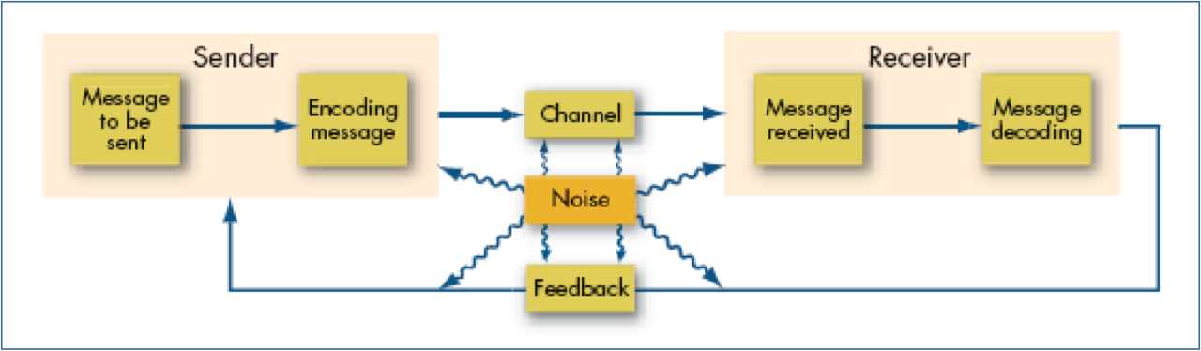
Communication Process
The communication process:
LECTURE 7: Communication ∙ Barriers ∙ Enhancing Effectiveness
Notes:
<number>

Slide 5
Communication Process
Once encoded, a message is transmitted through one of two types of general channels:
Formal channels that are proscribed by organization’s policies, procedures, and design; this can be vertically upward or downward, and horizontally lateral
Informal channels that are spontaneous, personal (between people), are regardless of anyone’s formal position; these often take the form of gossip or “grapevines” that arise when employees feel uninformed or lied to
LECTURE 7: Communication ∙ Barriers ∙ Enhancing Effectiveness

Slide 6
Communication Process
There are tradeoffs in capacity versus richness (ability to convey meaning) for different channels
LECTURE 7: Communication ∙ Barriers ∙ Enhancing Effectiveness
Notes:
<number>

Slide 7
Nonverbal Communication
Although most of our communication is verbal (oral or written), between 65-90% of the meaning in a given message is communicated nonverbally
Nonverbal communication is highly sensitive to sender/receiver charecteristis, and context
LECTURE 7: Communication ∙ Barriers ∙ Enhancing Effectiveness

Slide 8
Nonverbal Communication
There are 4 types of non-verbal communication:
Kinesics: Body movement and posture (e.g., clenching fists when stressed, “the finger”, hand-shaking
Face/Eye Behavior: Often reveal emotions, behavioral intentions, and provide cues to the receiver; eye contact and smiling can enhance active listening and empathy
Paralanguage: Variations in speech such as pitch, loudness, tempo, tone, duration, laughing, and crying
LECTURE 7: Communication ∙ Barriers ∙ Enhancing Effectiveness

Slide 9
Nonverbal Communication
Proximity: Physical closeness is an indicator of social/intimate closeness; receivers can be put in intimate, personal (e.g., friends), social, or public “zones”
LECTURE 7: Communication ∙ Barriers ∙ Enhancing Effectiveness

Slide 10
Barriers
When perceiving communication from others, people have perceptual filters that affect how they experience and react to that communication; these filters can be psychological, experiential, or situational
What are some examples of common perceptual filters?
Age, gender, values, beliefs, experiences, personality, cultural biases, needs, time pressures, excessive stimulation, moods, etc.
LECTURE 7: Communication ∙ Barriers ∙ Enhancing Effectiveness

Slide 11
Barriers
Three common perceptual tendencies:
Selective perception: People tend to notice and accept information that is consistent with their existing beliefs, values, and expectations
Attribution errors: People tend to either attribute others’ behavior to either external causes (defensive bias) or internal causes (fundamental attribution error), ignoring or downplaying the other
Self-serving bias: Tendency to attribute our own successes to internal causes, and our own failures to external causes
LECTURE 7: Communication ∙ Barriers ∙ Enhancing Effectiveness
Notes:
The defensive bias often arises when another person is similar to us; we are essentially defending our own self-worth by validating the externality of the failures of a similar other. The FAE is enhanced when we have a reason to believe another person is different from ourselves. Self-serving bias is likely to trigger when discussing behaviors and events that are especially important to us and our most salient identities.
<number>

Slide 12
Barriers
Other barriers may also distort, disrupt, or even halt successful communication:
Status differences: Intimidated when communicating upward or disinterested when downward
Gender: Different communication styles
Cultural diversity: Some place more importance on authority; many cultures have stereotypes of other cultures that create automatic perception barriers
Language: Cultural language, jargon and professional language can be efficient, but alienating to others
LECTURE 7: Communication ∙ Barriers ∙ Enhancing Effectiveness

Slide 13
Enhancing Communication
Active listening is seeking to fully understand the sender’s intended message, rather than focusing only on one’s response to the message
Four types of responses facilitate active listening:
Affirming contact: Communicate attentiveness, not necessarily agreement-lets person know your are listening – very non verbal
Paraphrasing: Repeat message back in own words
Clarify the implicit: Verbalize unsaid emotions/thoughts
Reflect core feelings: Identify underlying values (Not on exam) empathize at a deeper level
LECTURE 7: Communication ∙ Barriers ∙ Enhancing Effectiveness
Notes:
It is important to demonstrate empathy and concern for the communicator as a person, not an object; people communicate emotion for a reason
<number>

Slide 14
Enhancing Communication
Ways to improve your active listening skills:
Stop talking
Put the speaker at ease
Show the speaker you want to listen
Remove distractions
Empathize with the speaker
Be patient
Hold your temper
Go easy on criticism
Ask questions, paraphrase, and clarify
Stop talking! Be sure the speaker has finished before you talk
LECTURE 7: Communication ∙ Barriers ∙ Enhancing Effectiveness

Slide 15
Enhancing Communication
When responding, avoid defensiveness (passive aggression, reactivity, over-dominance, etc.) in favor of assertive communication, which is direct, clear, informative, respectful
The key is self-control when communicating:
Make your statement, then ask for opinions and wait until some have been voiced fully before responding
Minimize self-deprecation (unless being humorous)
Use “I” statements
Judge the behavior, not the person.
LECTURE 7: Communication ∙ Barriers ∙ Enhancing Effectiveness
Notes:
Power plays (restricting response choices, ignoring, insulting), labeling others as deficient/abnormal, spreading misleading information, hostile jokes (passive-aggressive)
<number>

Slide 16
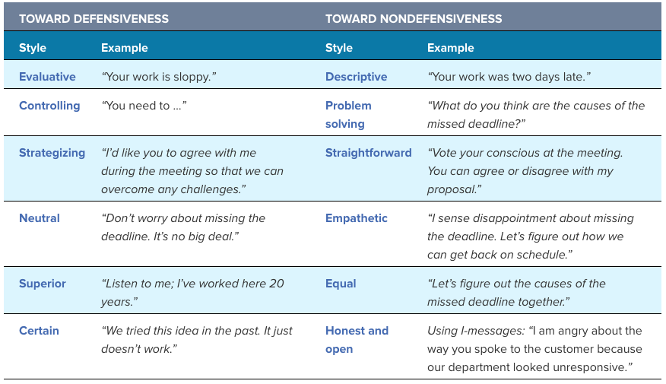
Enhancing Communication
LECTURE 7: Communication ∙ Barriers ∙ Enhancing Effectiveness
Notes:
Power plays (restricting response choices, ignoring, insulting), labeling others as deficient/abnormal, spreading misleading information, hostile jokes (passive-aggressive)
<number>

Slide 17
Enhancing Communication
Blending active listening and assertive communication together can help when having crucial conversations with employees; the book has a helpful acronym (STATE):
Share your facts: Begin with least controversial
Tell your story: Describe past and ideal future
Ask for facts/stories: Create a dialogue
Talk tentatively: Your opinions are not facts
Encourage testing: Make a psychologically safe environment, don’t intimidate or interrupt
LECTURE 7: Communication ∙ Barriers ∙ Enhancing Effectiveness
Notes:
Share your facts. Start with the least controversial, most persuasive elements that support what you want for yourself and for the relationship.
Tell your story. Enhance what you want by describing what has happened, how you’ve arrived where you are, how you’d like to see it change, and why. It may help to add what you don’t want personally or for the relationship.
Ask for others’ facts and stories. This is key to creating dialogue, which is essential if you’re to have a productive crucial conversation. Don’t talk at but instead talk with others. Approach all crucial conversations as two-way exchanges. Don’t be accusatory, but instead simply describe the situation, the way you feel, and what you would like to see happen. Use “I” instead of “you.”
Page 368Talk tentatively. Keep in mind that you’re telling a story, not stating facts. The facts come first, then you can add “color” or describe the impact on you via your story. In other words, don’t pound the podium and talk like you’re “preaching” facts.
Encourage testing. Make it safe for others to share their (opposing) views. Allow them to share or test their ideas, thoughts, and feelings. Don’t interrupt, steamroll, or intimidate. It is critical to maintain mutual respect during crucial conversations. One way to do this is to explain and focus on mutual purpose—what you both stand to gain. Be sure the other person respects you in order to avoid defensiveness (recall what you learned earlier in this chapter) and conflict. If it’s appropriate, apologize to get back on track.⁹⁰
<number>

Slide 18
Enhancing Communication
Please review the Social Media and Increased Productivity section on your own
LECTURE 7: Communication ∙ Barriers ∙ Enhancing Effectiveness
Notes:
Power plays (restricting response choices, ignoring, insulting), labeling others as deficient/abnormal, spreading misleading information, hostile jokes (passive-aggressive)
<number>

